Slide 1
What Powers the Faint (μJy) Radio Source Population?
Space Grant Intern: Liam Nolan
Mentor: Dr. Rolf Jansen

Slide 2
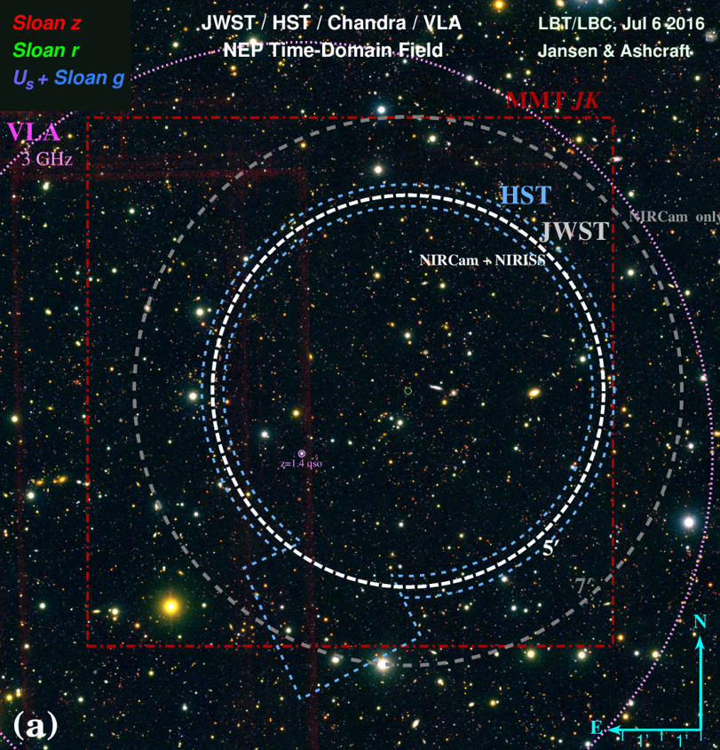
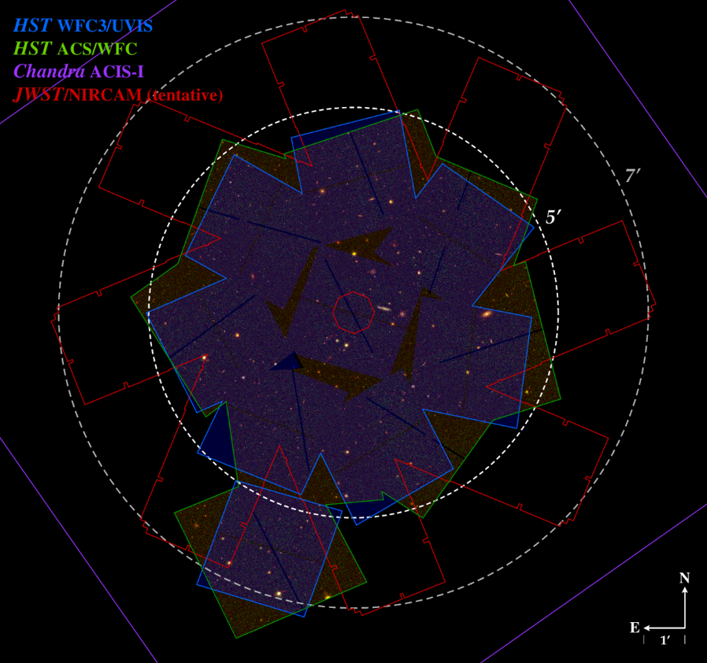
JWST and the North Ecliptic Pole Time-Domain Field
Planned start of JWST science observations in Fall 2021, including guaranteed time by R. Windhorst and team (GTO program #1176)
Survey of NEP TDF in 8 near-IR filters + slitless spectroscopy
Most suitable field for time-domain studies
  Visible year-round
  Low zodiacal foreground
Important to undertake significant background study on field
  Deep VLA 3GHz (~10cm) radio continuum observations

Slide 3
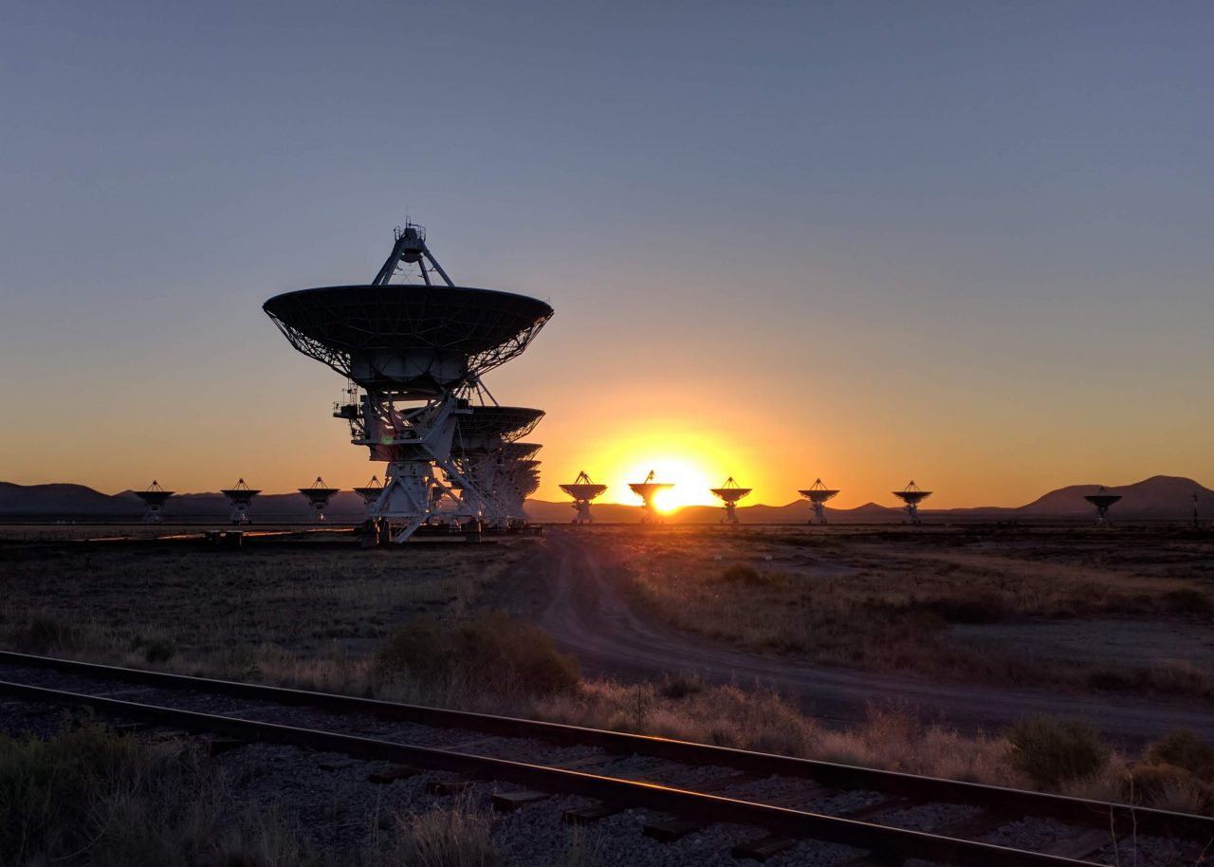
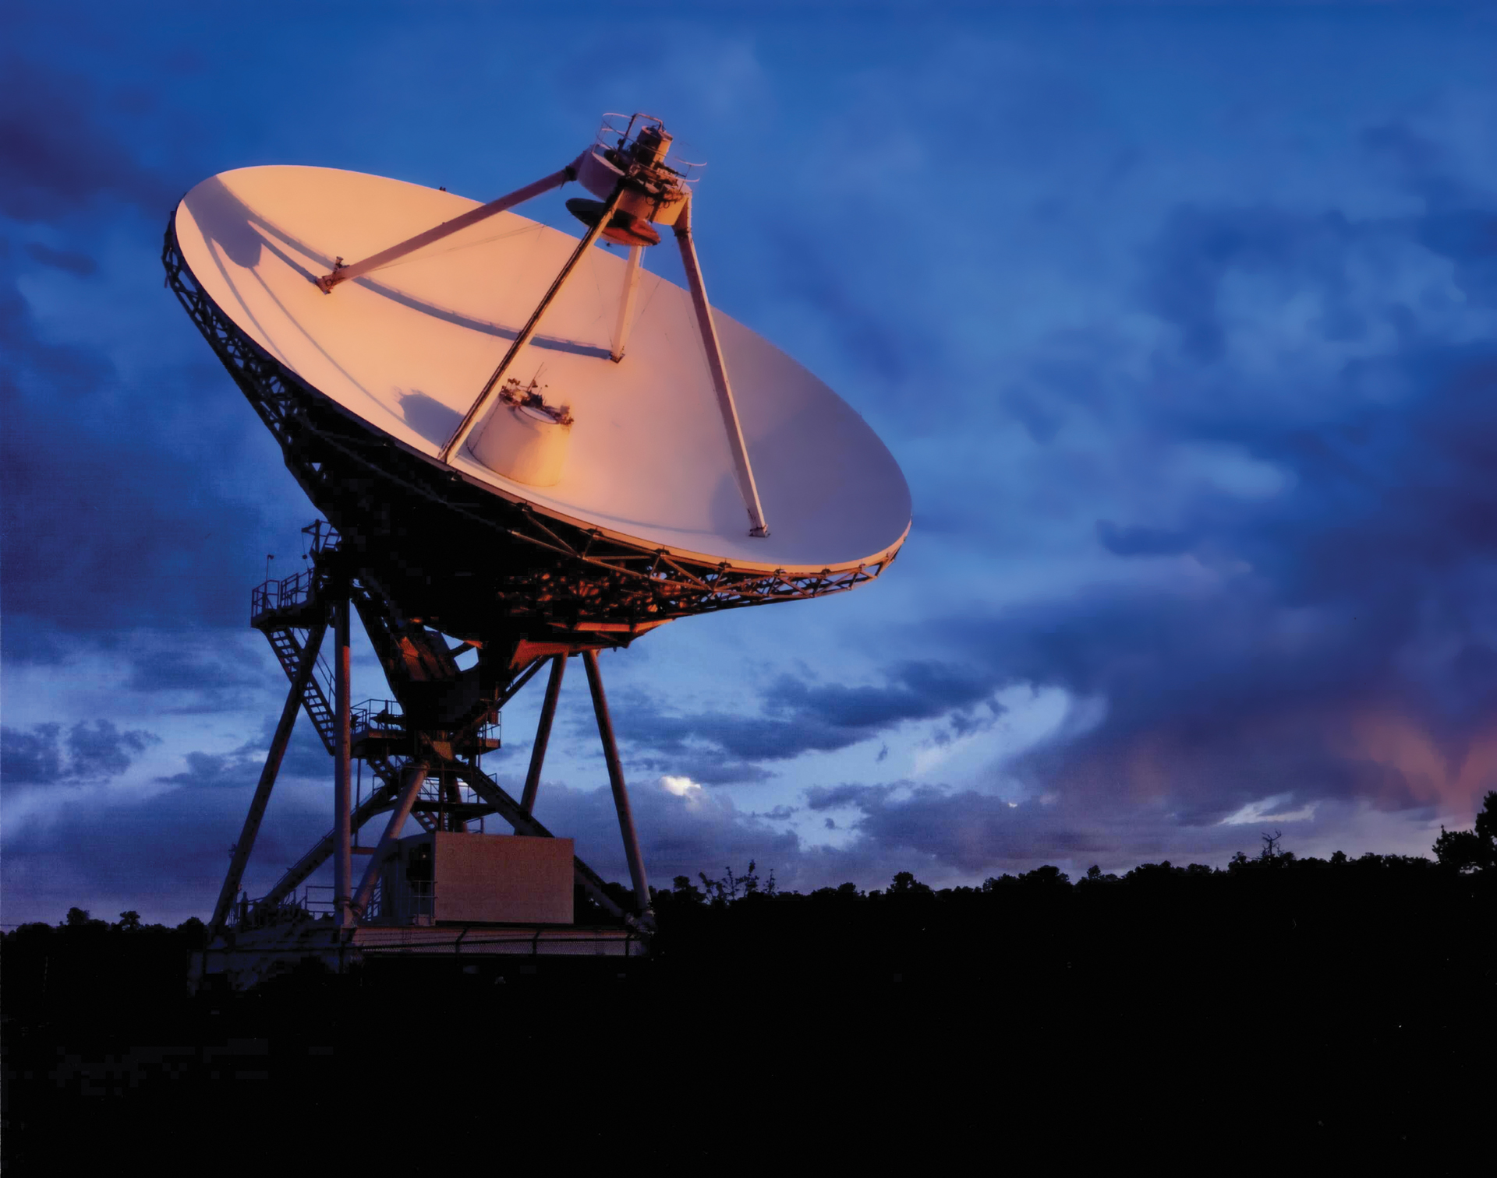
Very Large Array & Very Long Baseline Array Observations
Credit: NRAO/AUI/NSF
Notes:
Image locations: https://public.nrao.edu/gallery/sunrise-at-the-vla/
https://public.nrao.edu/gallery/red-sky-in-morning/

Slide 4
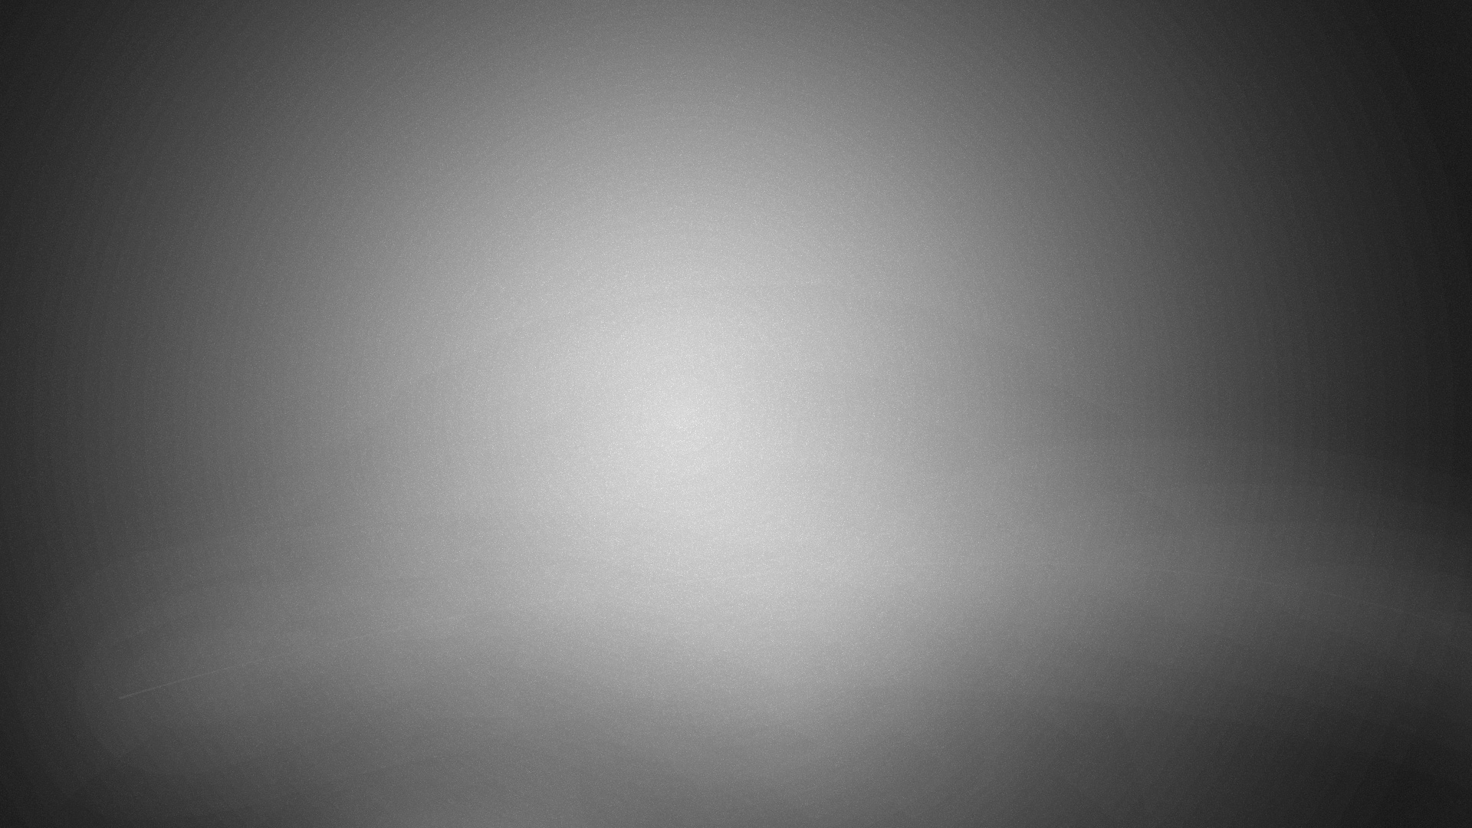
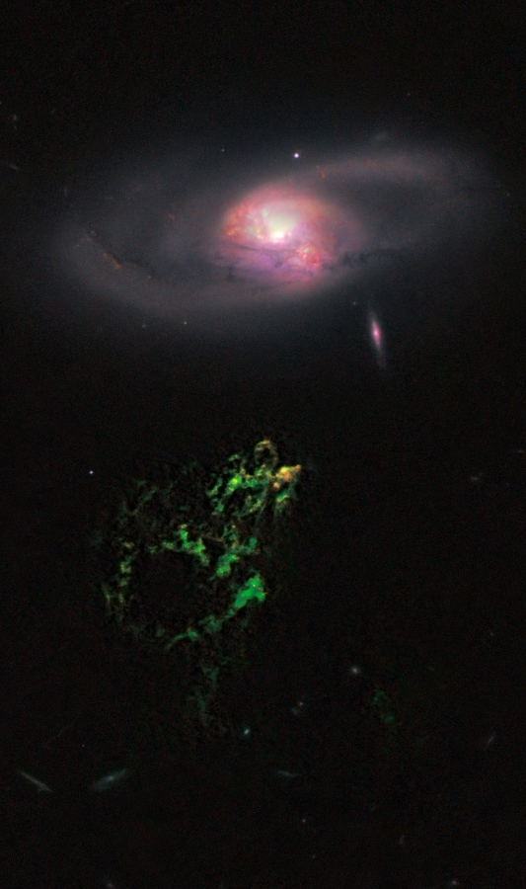

The Faint Radio Source Population
~47 hrs. of jVLA 3 GHz observations in B and A configuration (PI: Windhorst)
  Depth of ~0.9 μJy (4$σ$) at ~1” resolution (FWHM)
~147 hrs. of VLBA 4.8Ghz long-baseline radio observations (PI: Brisken)
  Depth of ~20 μJy (6$σ$) at ~3 mas resolution (FWHM)
Assumed to be primarily star-forming, with ~10% AGN, but not confirmed
Seek patterns in near-IR and visual images for AGN signature, i.e. central point source or color
  LBT/LBC Ugiz (PI: Jansen)
  HST WFC3/UVIS F275W + ACSWFC F435W+F606W (PI: Jansen)
  MMT/MMIRS YJHK (PI: Wilmer)
Far-IR observations lacking in field, req. large-aperture cryogenic space mission
If proportion of star-formation to AGN holds, promising for use of radio data in lieu of more difficult FIR
Credit: NASA APOD
Notes:
Image location: https://apod.nasa.gov/apod/ap110210.html

Slide 5
Methods: Differentiating Between Star-Formation and AGN
VLA detects a variety of sources due to its relatively wide resolution
  Identifies locations for object pointings
VLBA, with finer resolution, only detects near-point sources
SF sources are extended throughout galaxy, AGN produce most to all of emissions from the galaxy center
Further and more accurate differentiation requires UV/Visible/NIR
  Mixed cases (i.e. SF + weak AGN)
  Object confusion (off-centered point sources)

Slide 6
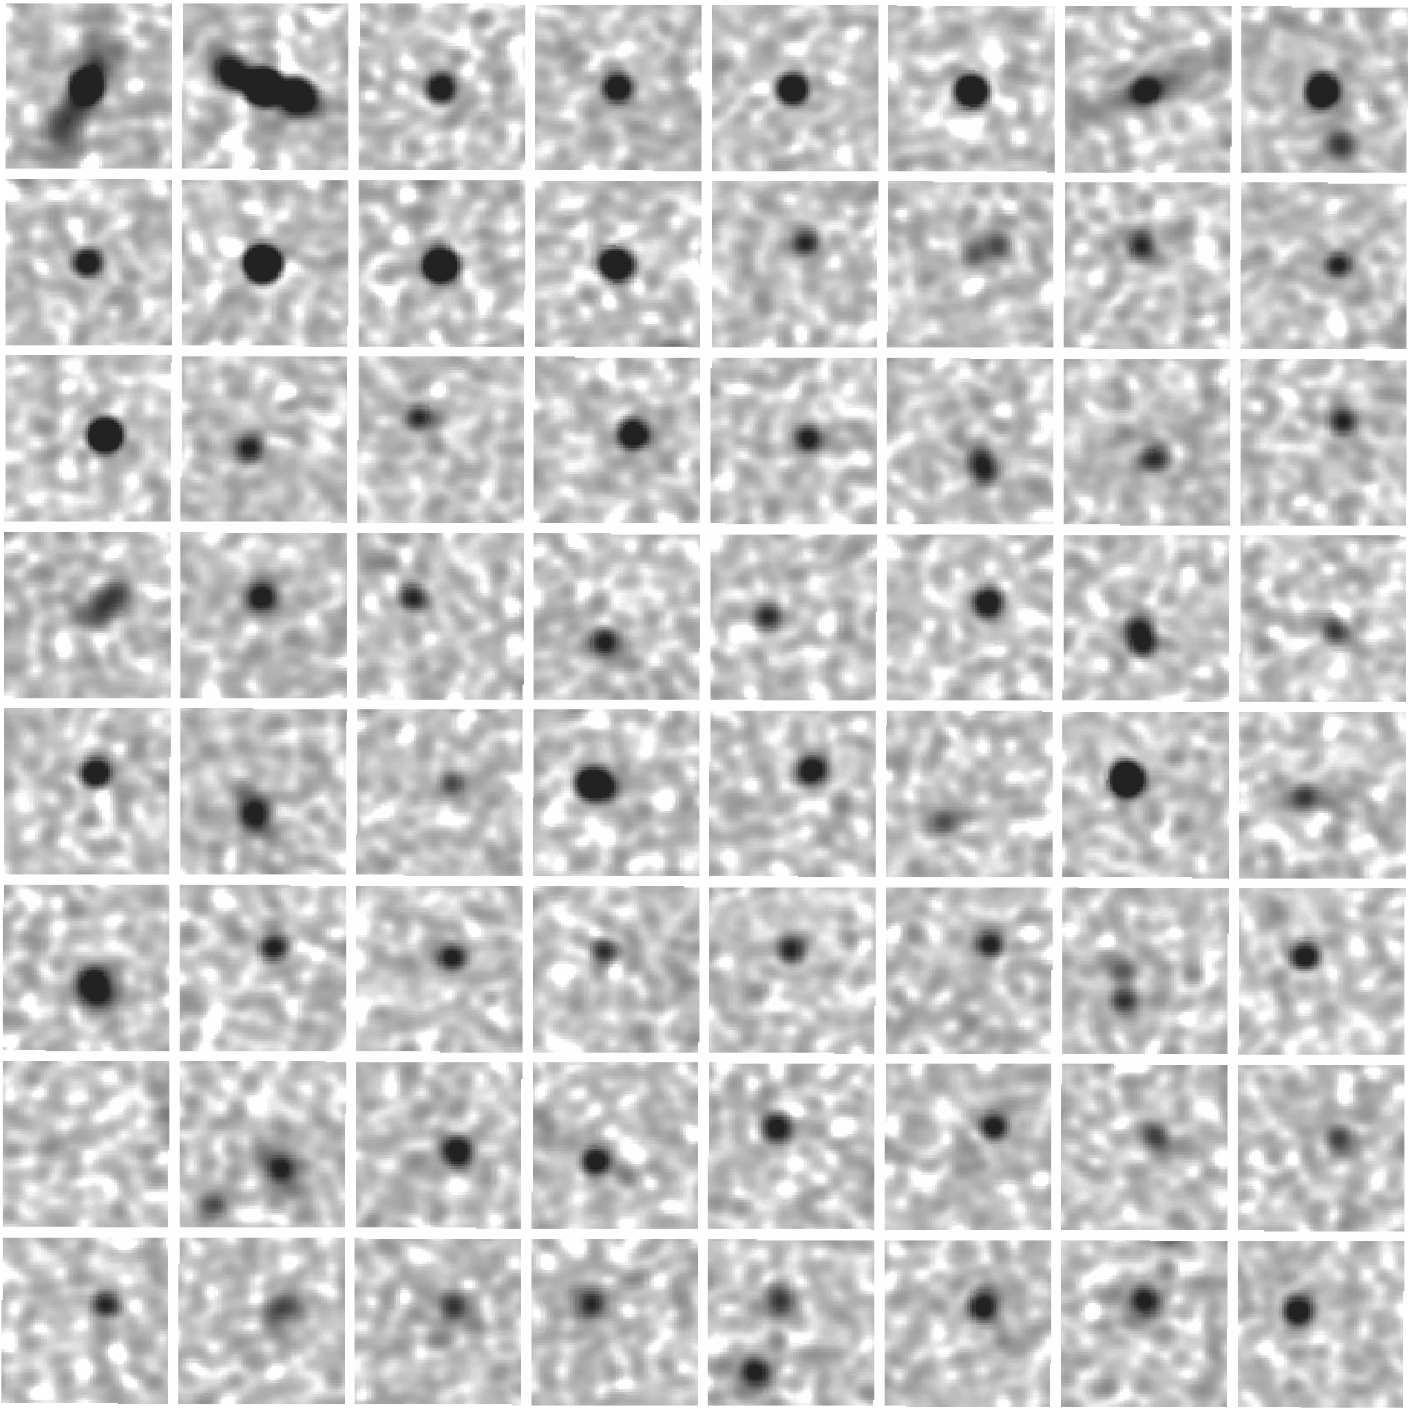
Results
Excised 64x64 pixel “postage stamps” of all ~2500 VLA-detected sources
Preliminary results show 12 VLBA detections at ~20 μJy of ~130 VLA sources targeted
Developed color composites for VLBA-detected sources and a comparison set of non-detections
  Excised 136x136 (~5” square) pixel stamps from HST where available
  Others are 30x30 (~5” square) pixel stamps from LBT/LBC
Planning to analyze demographics of these populations
  Consistent visible presence of AGN-sources in Visible, less consistent with SF

Slide 7
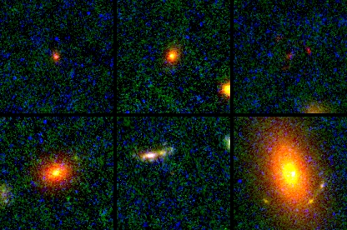
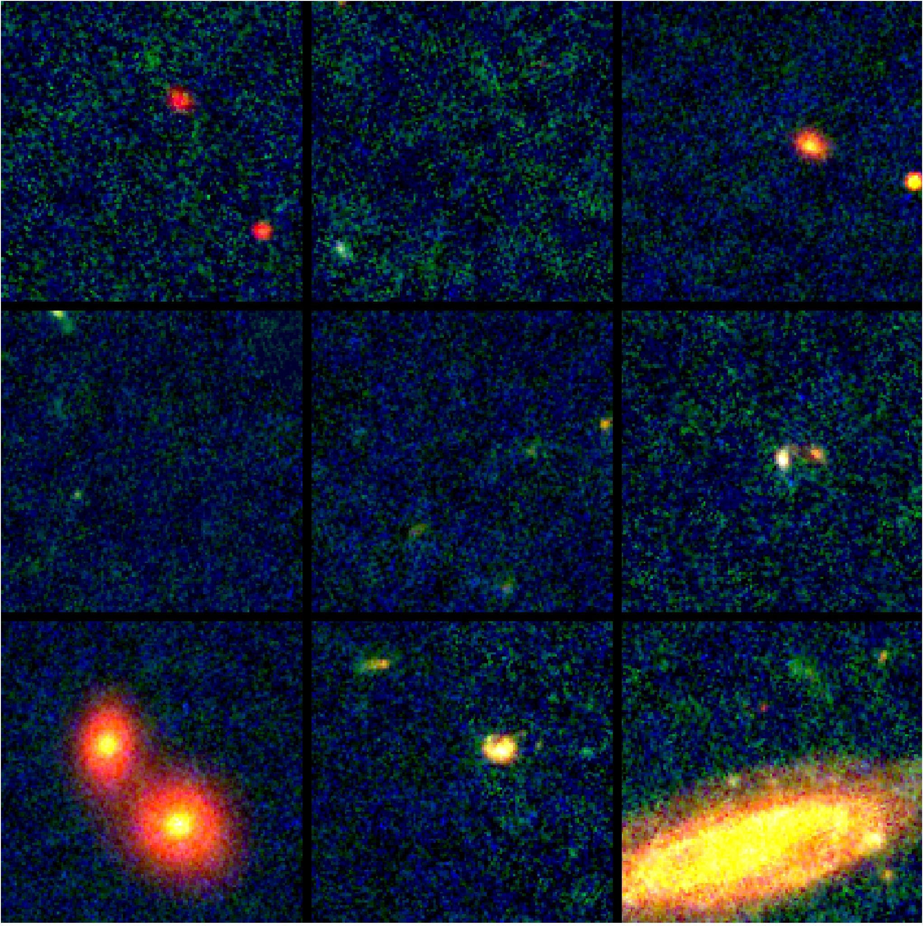
Results: Visual Composites

Slide 8
Acknowledgements & Thanks
Data
R. Windhorst (ASU), B. Cotton (NRAO), W. Brisken (NRAO), J. Gelfand (NYU), R. Wrzosek (NYU), A. Matthews (UVA), C. Wilmer (UofA), W. Maksym (CfA), T. Ashcraft (ASU).
Support
R. Windhorst, S. Cohen, B. Joshi (ASU)
…and of course Dr. Rolf Jansen and the ASU/NASA Space Grant

